Slide 1
Crash Severity Prediction
Asif Irfanullah Masum & Ifrat Zaman

Slide 2
Introduction
Road traffic crashes cause significant public health issues with millions of people affected every year, resulting in enormous social and economic costs.
Government agencies and institutions have implemented various interventions to address road safety; designing safer infrastructure, improving vehicle safety features, driver behavior.
ML techniques are revolutionizing the way crash datasets are analyzed and interpreted, providing potential insights to improve road safety and prevent future accidents.
Predicting freeway crash injury severity based on environmental and human factors can assist first responders and medical personnel to prioritize the most seriously injured victims and provide them with necessary medical care.
Developing a machine learning model to predict freeway crash injury severity using a crash dataset can provide valuable insights to improve post-crash care for victims of road crashes and help develop accurate diagnosis and remedial measures for road traffic operational problems.

Slide 3
Project Objective
The project is divided into two components:
i. Creating a machine learning prediction model that predicts road crash injury severity based on environmental factors such as weather condition, lighting condition, and road condition
ii. Creating a machine learning prediction model that predicts road crash injury severity based on human factors such as alcohol and drug consumption, and hazardous actions taken by the driver

Slide 4
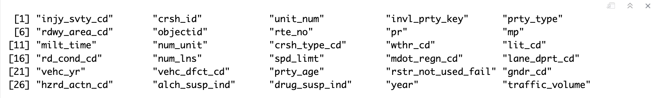
Dataset Description
The freeway crash dataset used for this project is obtained from Western Michigan University Transportation Research Center for Livable Communities (TCRLC).
The data was provided by the Michigan State Police, Office of Highway Safety Planning, to WMU for research and learning purposes.
The dataset consists of 399,794 observations with the following features:

Slide 5
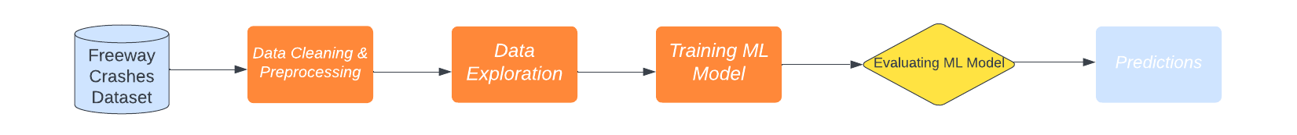
Architecture & Diagram

Slide 6
Data Cleaning & Preprocessing
Creating two subsets of the dataset:
Environmental factors subset:
21,655 null and 4,147 duplicate values
Dimension after data cleaning: 374,099 x 6
Human factors subset:
31,125 null and 4,147 duplicate values
Dimension after data cleaning: 371,684 x 7

Slide 7

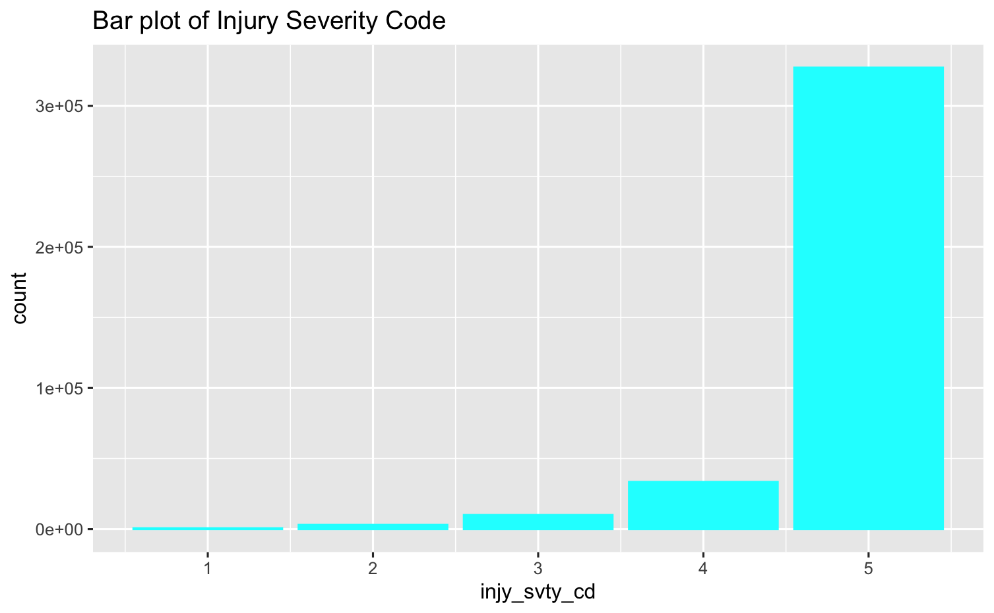
Data Exploration
There is an imbalance in the number of observations in each category of injury severity.
No injury >> all other categories
Created RShiny App for visualization
 | 1 | Fatal injury (K) 2 | Incapacitating injury (A) 3 | Non-incapacitating injury (B) 4 | Possible injury (C) 5 | No injury (O) Null | Not Entered

Slide 8
Training ML Models
Environmental Factors Subset:
Feature Matrix: wthr_cd, lit_cd, rd_cond_cd, mdot_regn_cd, invl_prty_key
Human Factors Subset:
Feature Matrix: vehc_dfct_cd, rstr_not_used_fail, hzrd_actn_cd, alch_susp_ind, drug_susp_ind,invl_prty_key
Target Vector: injy_svty_cd
Machine Learning Model: Multinomial Logistic Regression

Slide 9
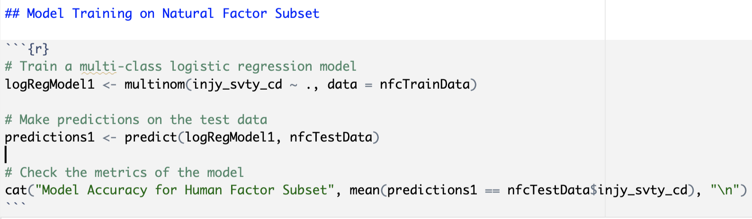
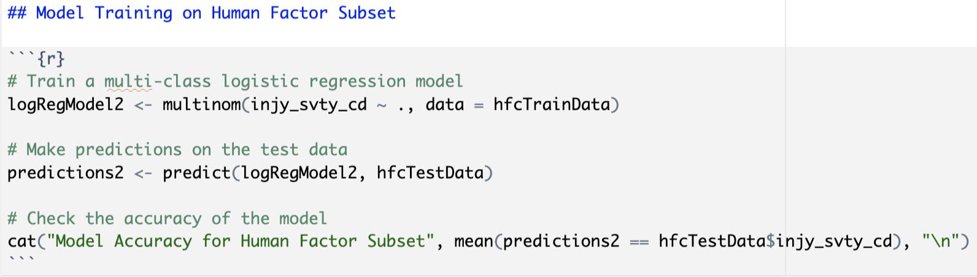
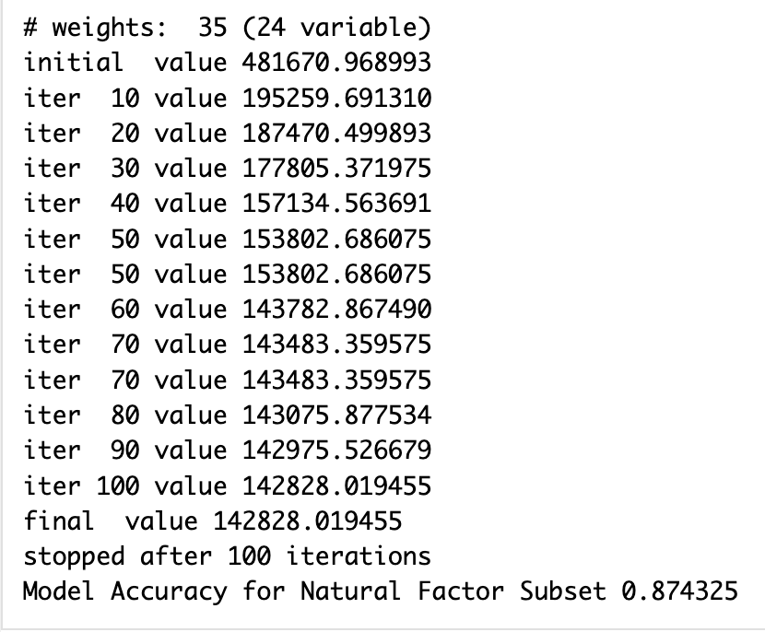
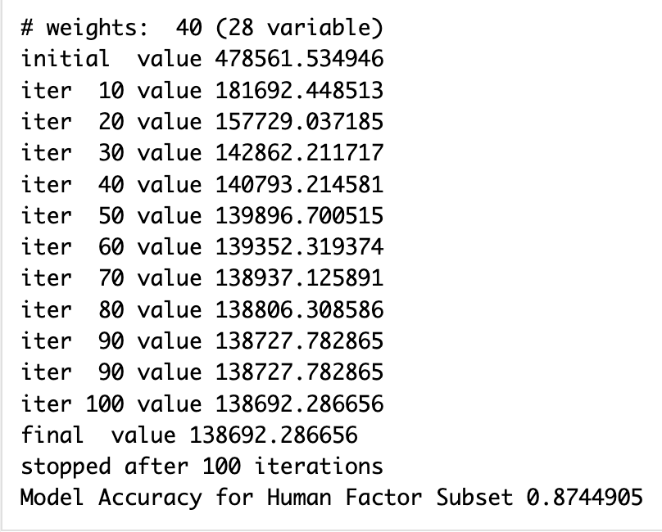
Model Evaluation
Environmental Factors Subset
Human Factors Subset

Slide 10
Conclusion
The machine learning model achieved an accuracy score of 87.43% for environmental factors and 87.45% for human factors, demonstrating its potential to accurately predict freeway crash injury severity and improve post-crash care for victims
The results of this project highlight the potential of machine learning techniques to analyze and interpret crash datasets effectively and provide insights to inform the development of more effective interventions and policies to prevent future accidents
By predicting injury severity, the model can assist first responders and medical personnel in prioritizing the most seriously injured victims and providing them with the necessary medical care, thus enhancing road safety and saving lives.

